Slide 1
Hands on project
Malaria classification
U-net segmentation

Slide 2
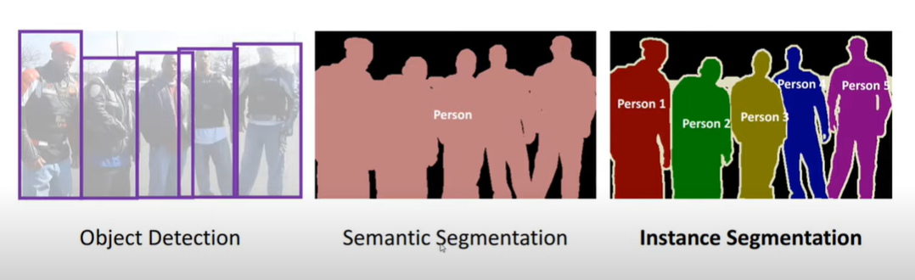
Notes:
Instance segmentation identifying each person from the background separately.

Slide 3
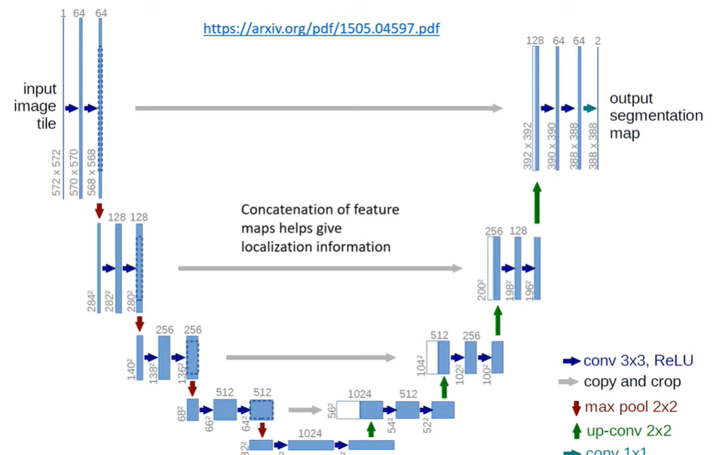
U net architecture for biomedical img segmentation
Notes:
U-Net is a semantic segmentation technique originally proposed for medical imaging segmentation.

Slide 4
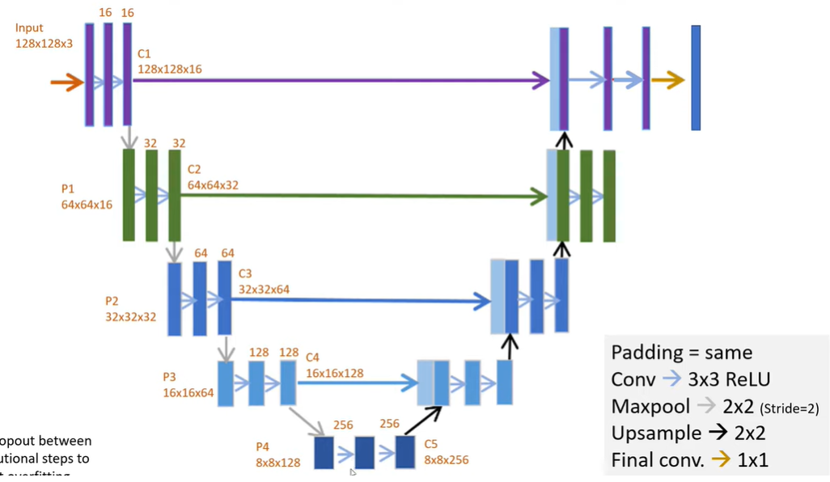

Slide 5
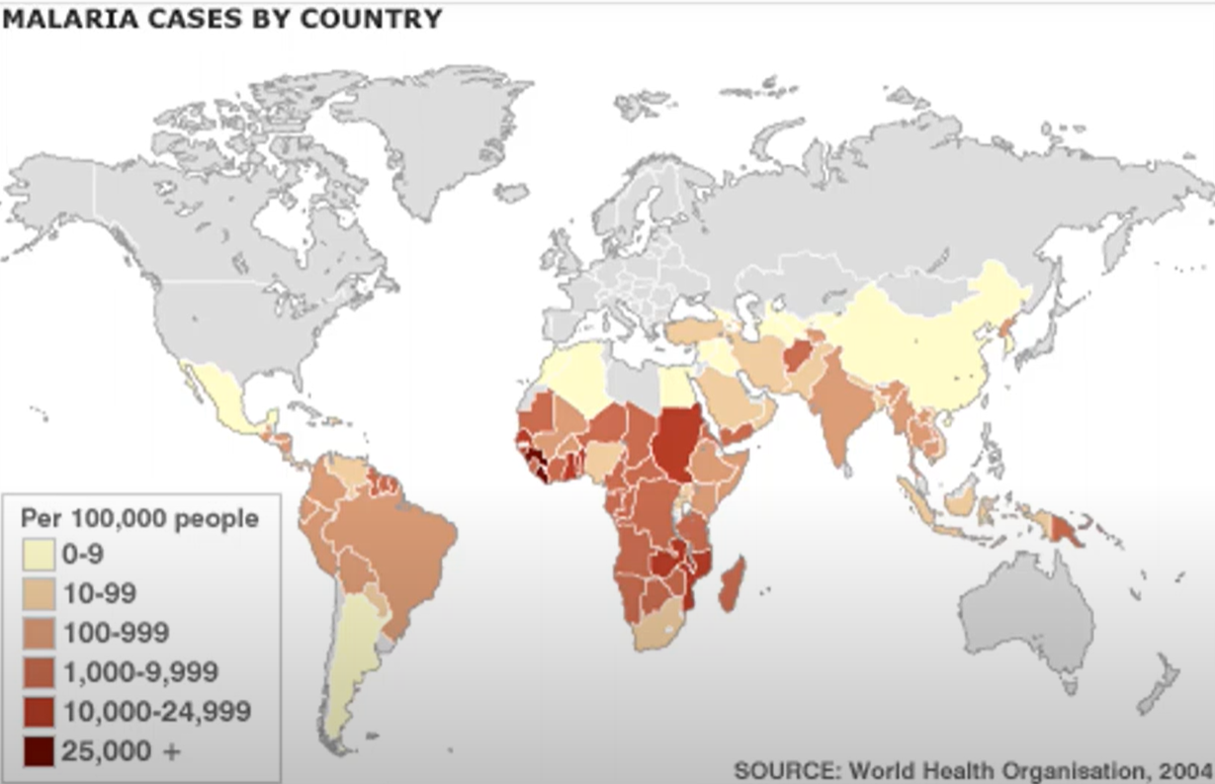

Slide 6
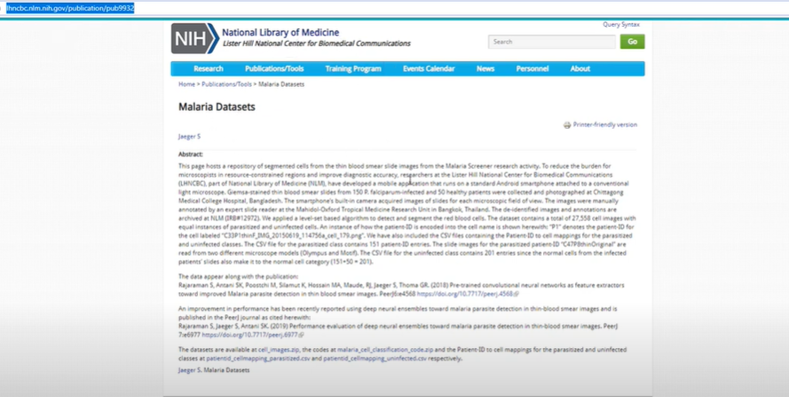
Dataset

Slide 7
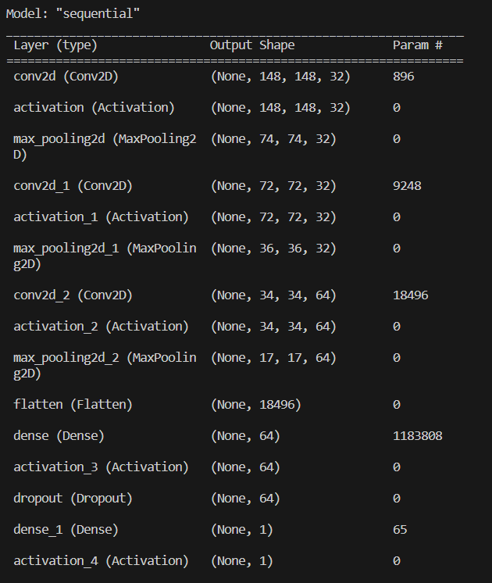
Malaria Cell classification task

Slide 8
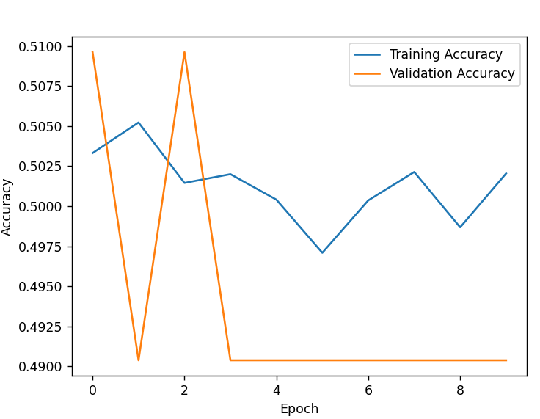
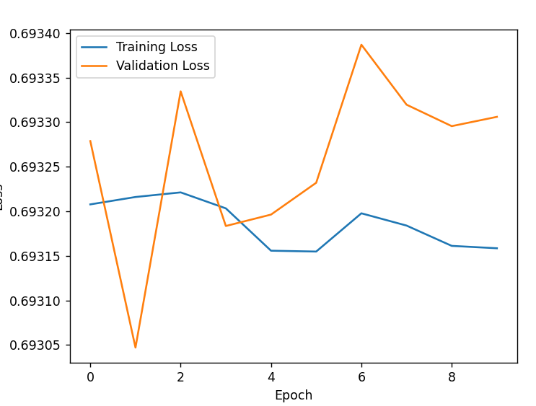
Notes:
Try to train the model longer

Slide 9
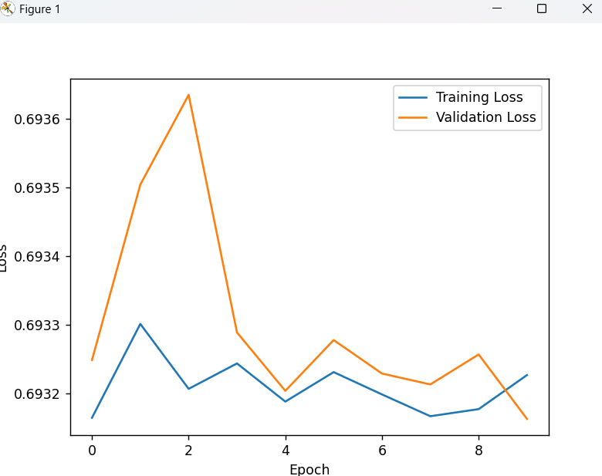
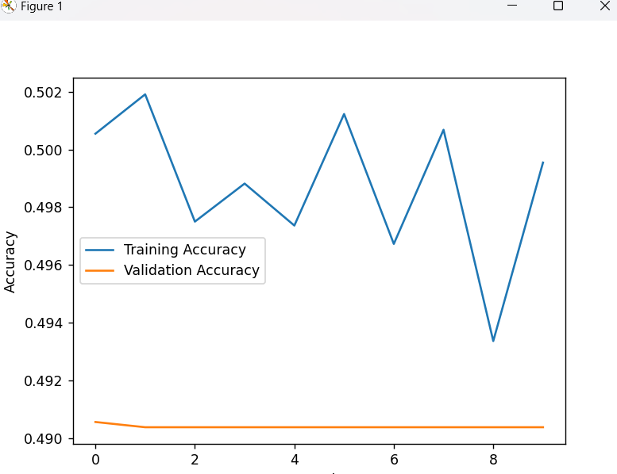
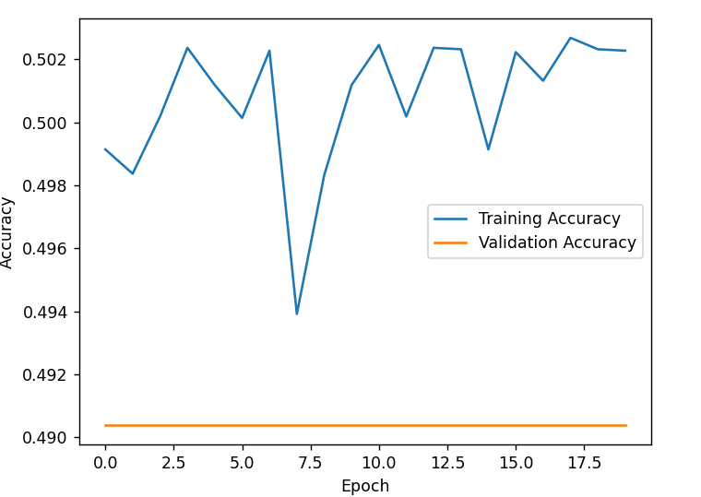
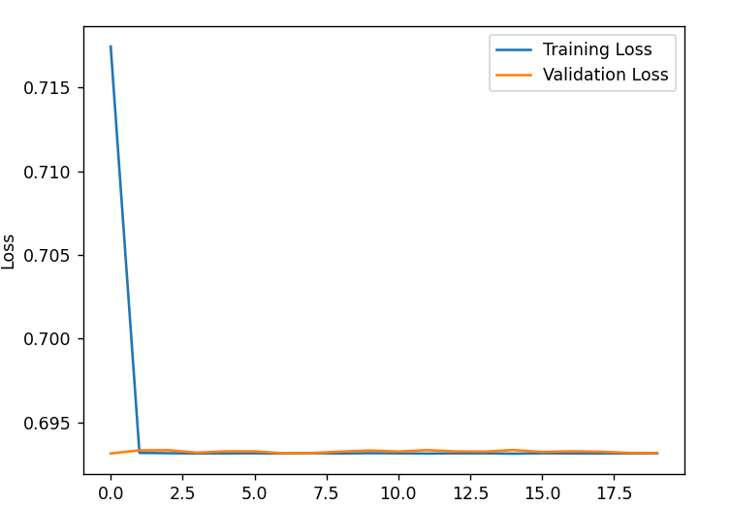
After the data augmentation
Notes:
trie d different params ar regaluzation, 20 epoch

Slide 10
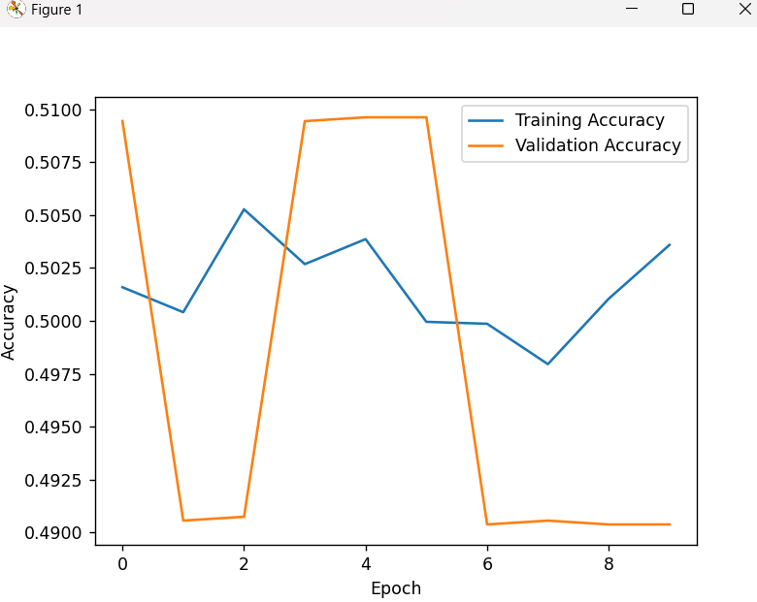
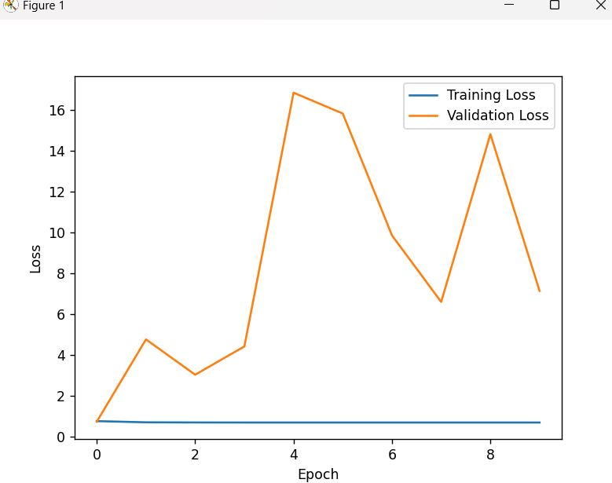

Slide 11
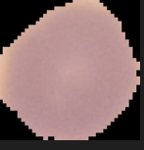
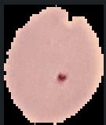
Testing the model

Slide 12
Conv2d
Activation
MaxPooling2D
Flatten
Dense
Dropout

Slide 13
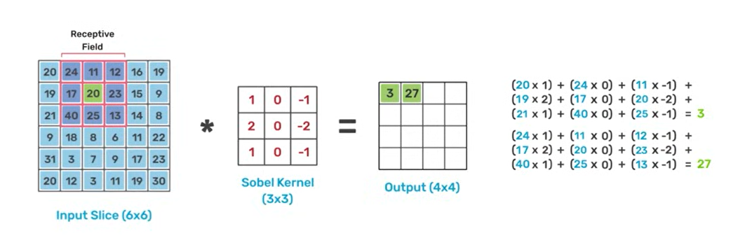
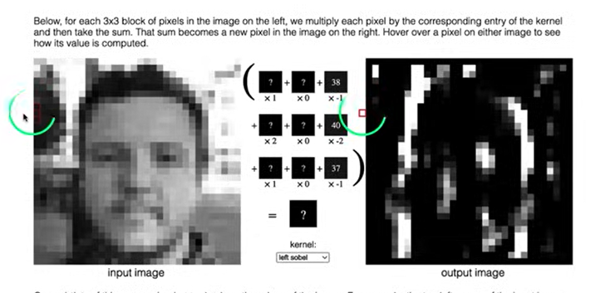
2D convolution
Convolution is nothing but a filter which is applied on image to extract feature from it. We will use such different convolutions to extract different features like edges, high-lighted patterns from the image.

Slide 14
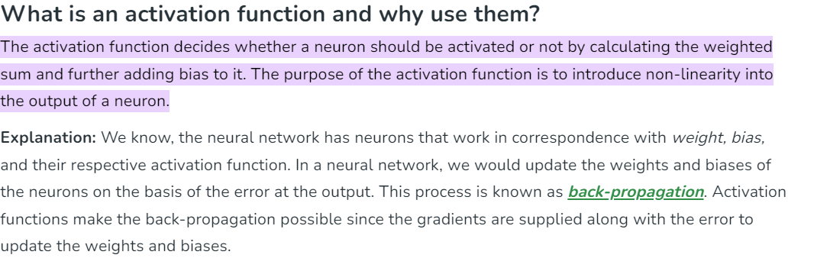

Slide 15
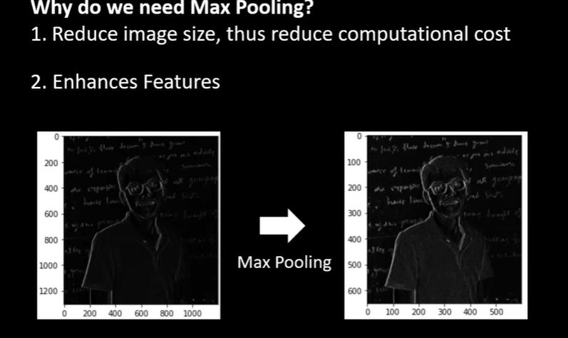
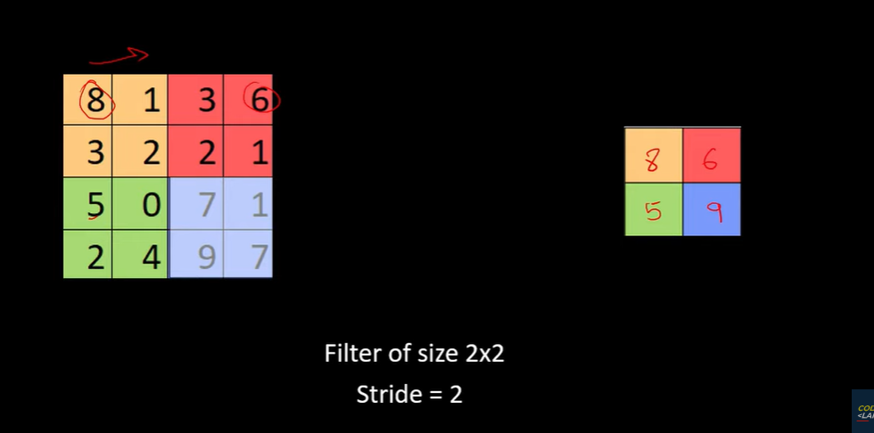
Max pooling
Reducing the size/computational cost, making the operation fast
Enhance the features, reduces the size of the image
We don't have to do it each time after 2D convolution
No parameters/ a simple transformation

Slide 16
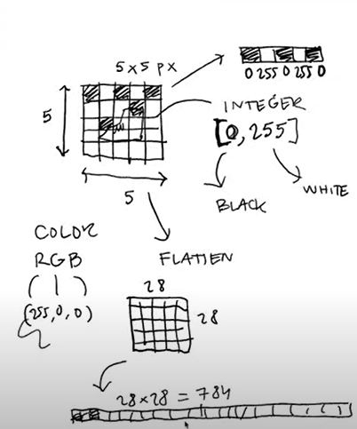
Flatten layer
From 28*28 to an array of a 1 dim array of 784

Slide 17
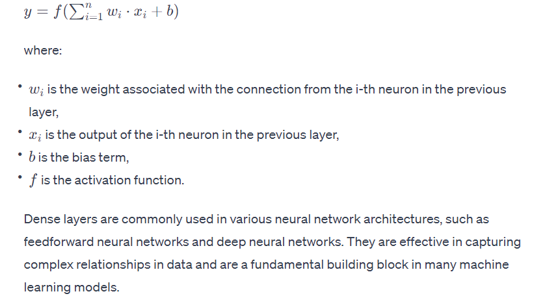
Dense layer / fully connected layer
In a dense layer, each connection has a weight associated with it, and the network learns these weights during the training process.
Notes:
Learn from the date/is a core component, an essential part as well as 2D

Slide 18
dropout layer
In deep neural networks, overfitting usually occurs because certain neurons from different layers influence each other. Simply put, this leads, for example, to certain neurons correcting the errors of previous nodes and thus depending on each other or simply passing on the good results of the previous layer without major changes. This results in comparatively poor generalization.
By using the dropout layer, on the other hand, neurons can no longer rely on the nodes from previous or subsequent layers, since they cannot assume that they even exist in that particular training run. This leads to neurons, provably, recognizing more fundamental structures in data that do not depend on the existence of individual neurons.
Drops the data

Slide 19
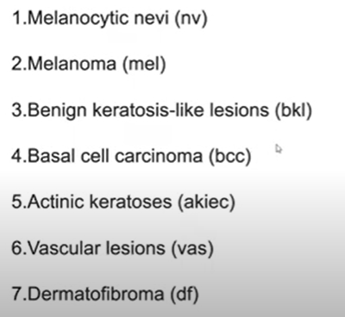
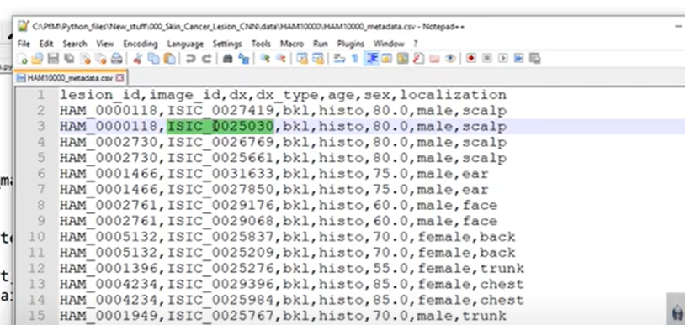
Metadata

Slide 20
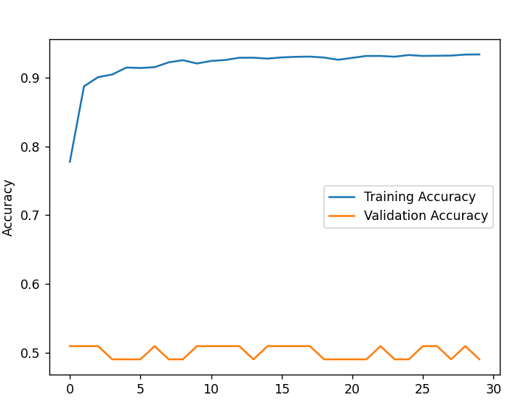

Slide 21
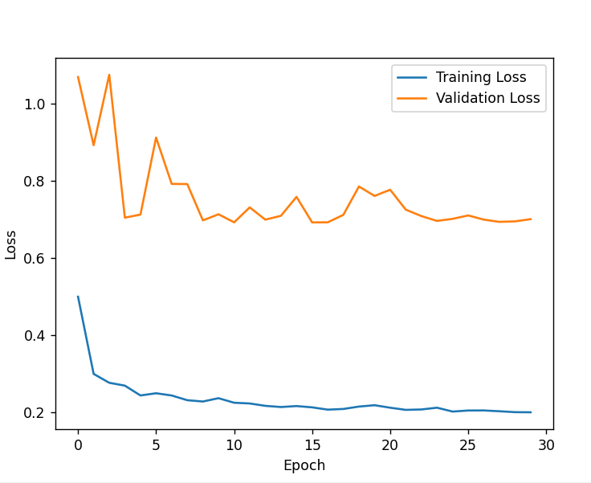

Slide 22
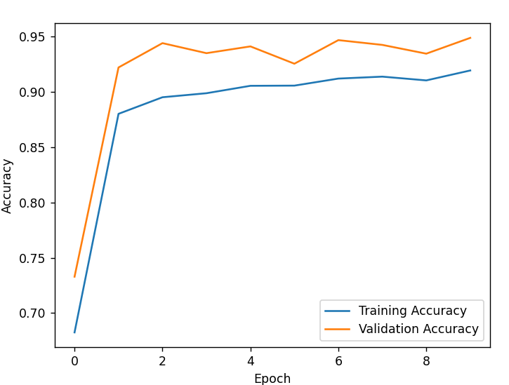
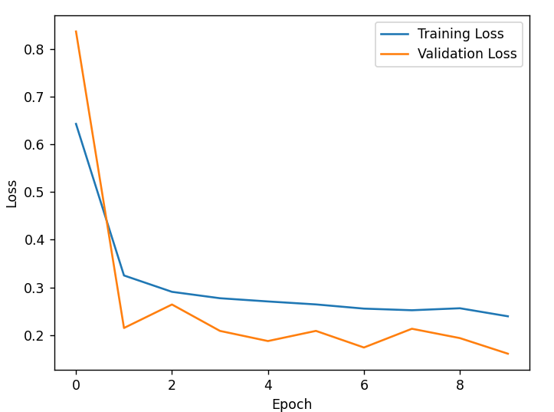

Slide 23
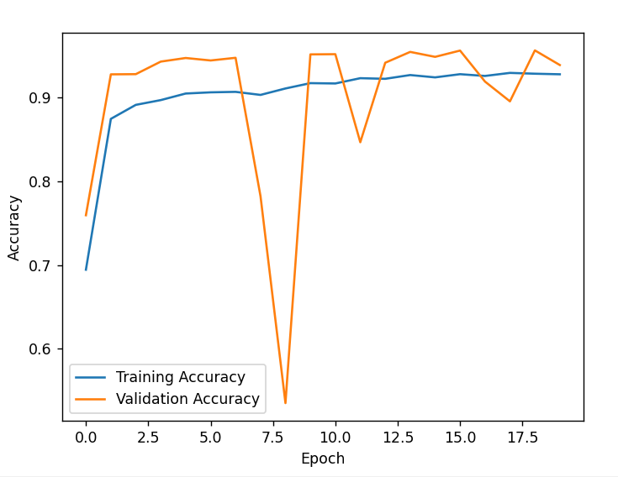
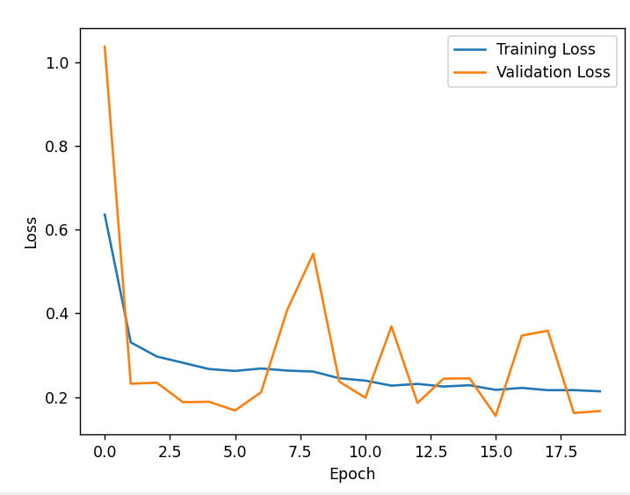

Slide 24
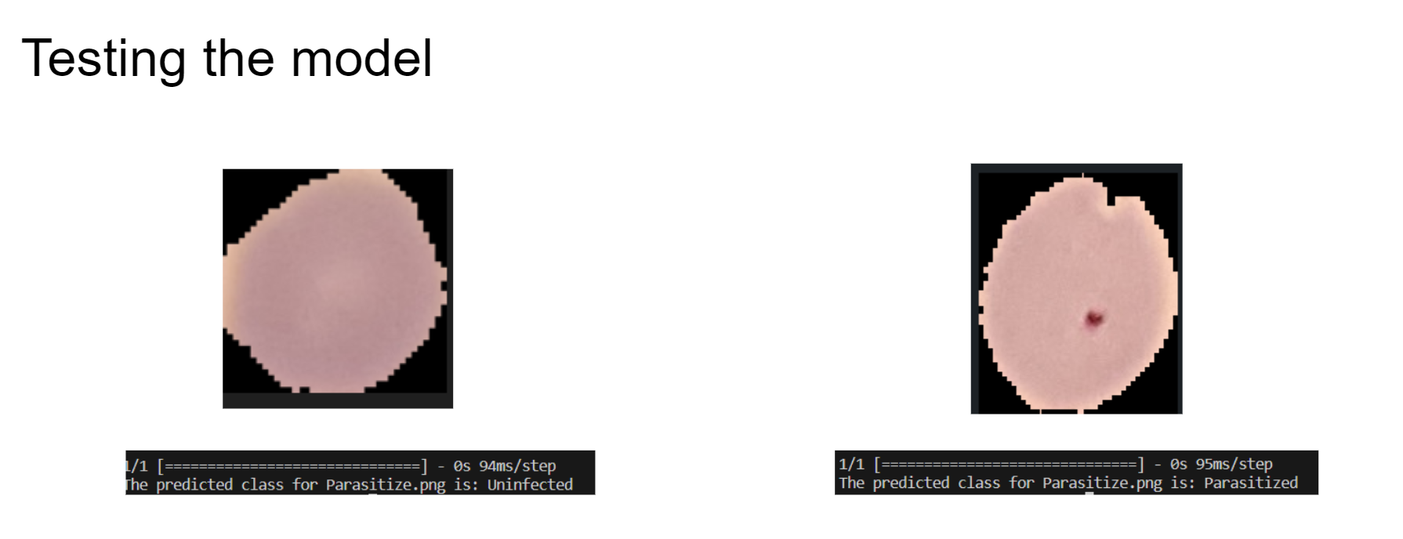

Slide 25
